Slide 1
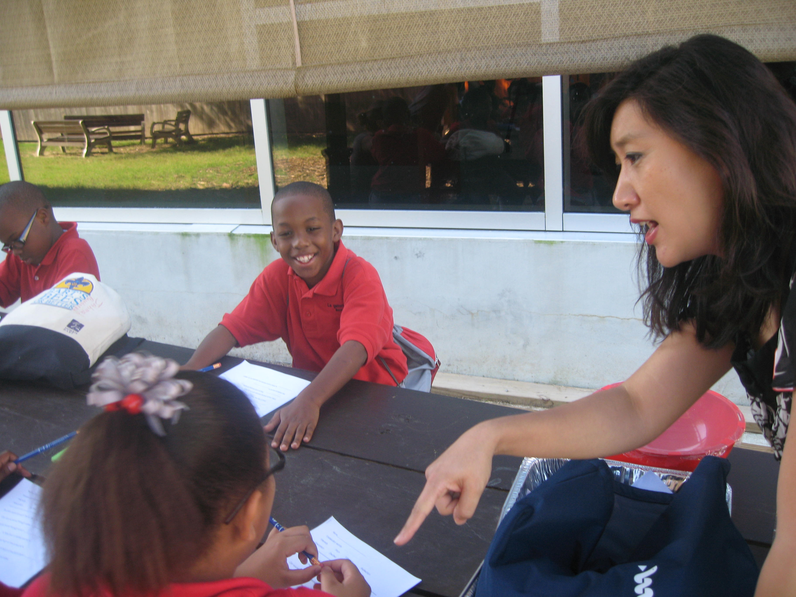
Learning About Sound

Slide 2
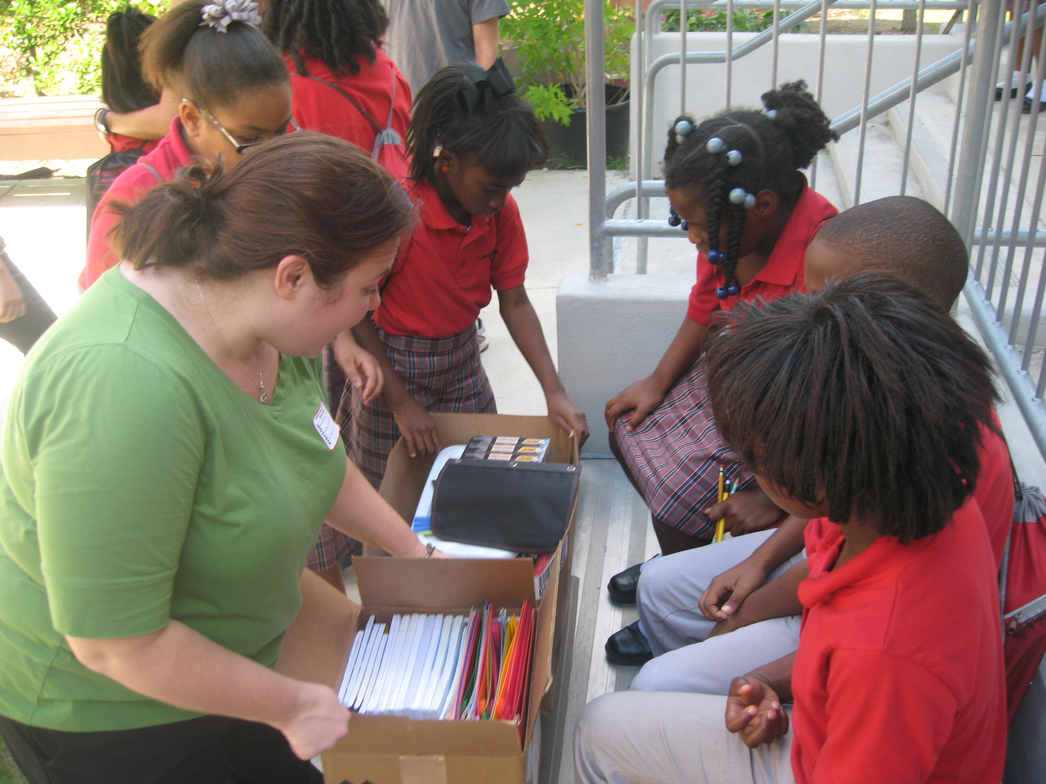
School Supply Donations

Slide 3
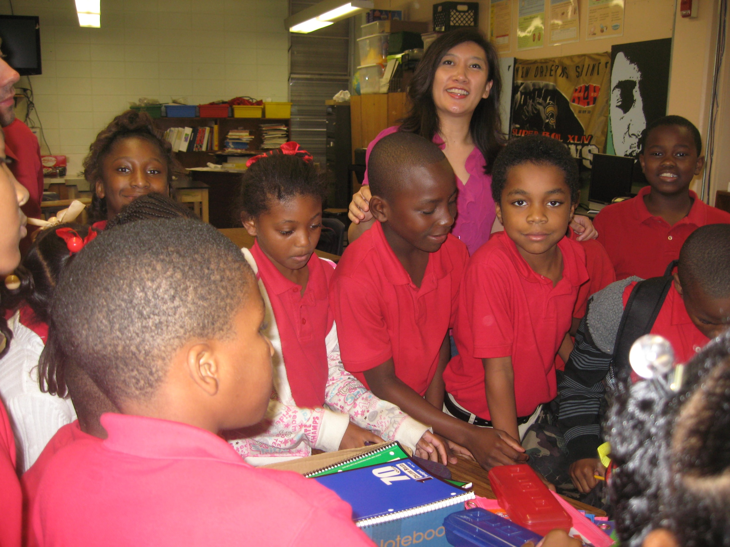
School Supply Donations

Slide 4
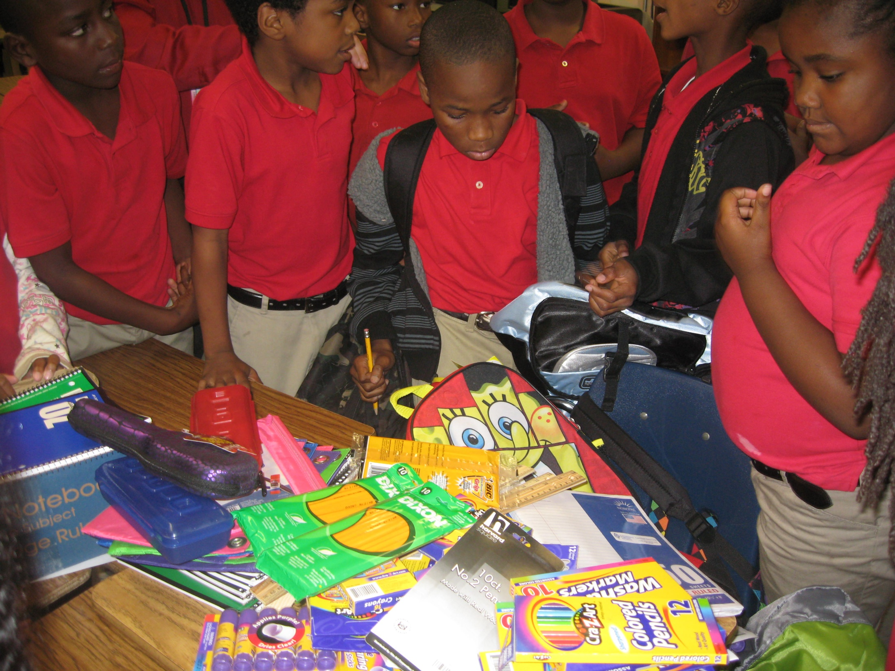
School Supply Donations

Slide 5
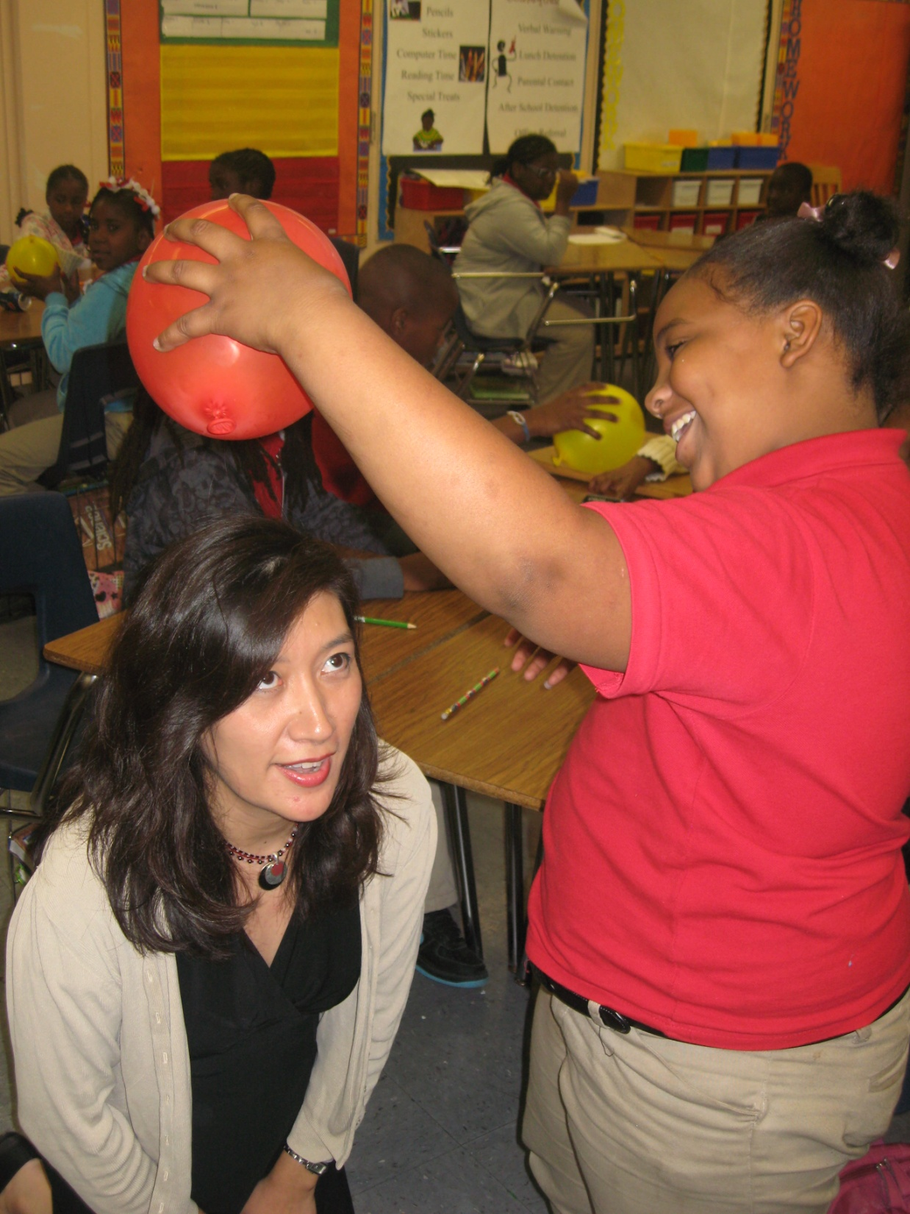
Learning About
Static Electricity

Slide 6
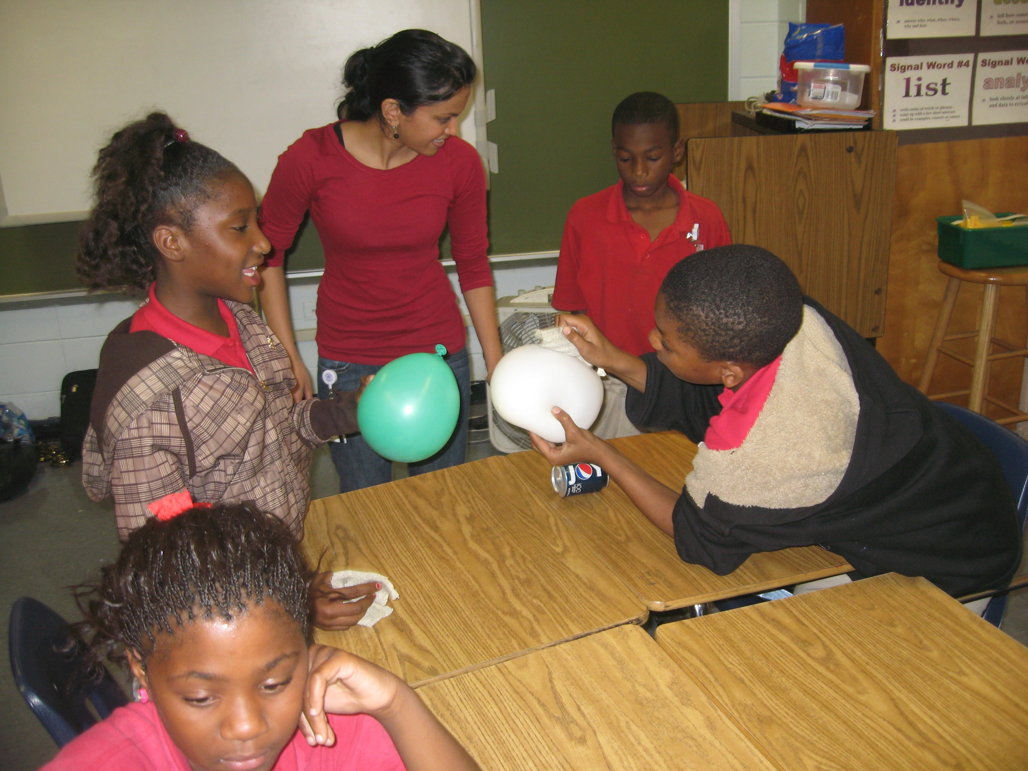
Learning About Static Electricity

Slide 7
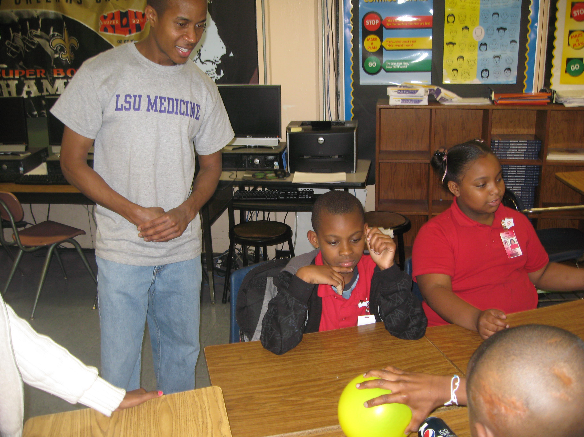
Learning About Static Electricity

Slide 8
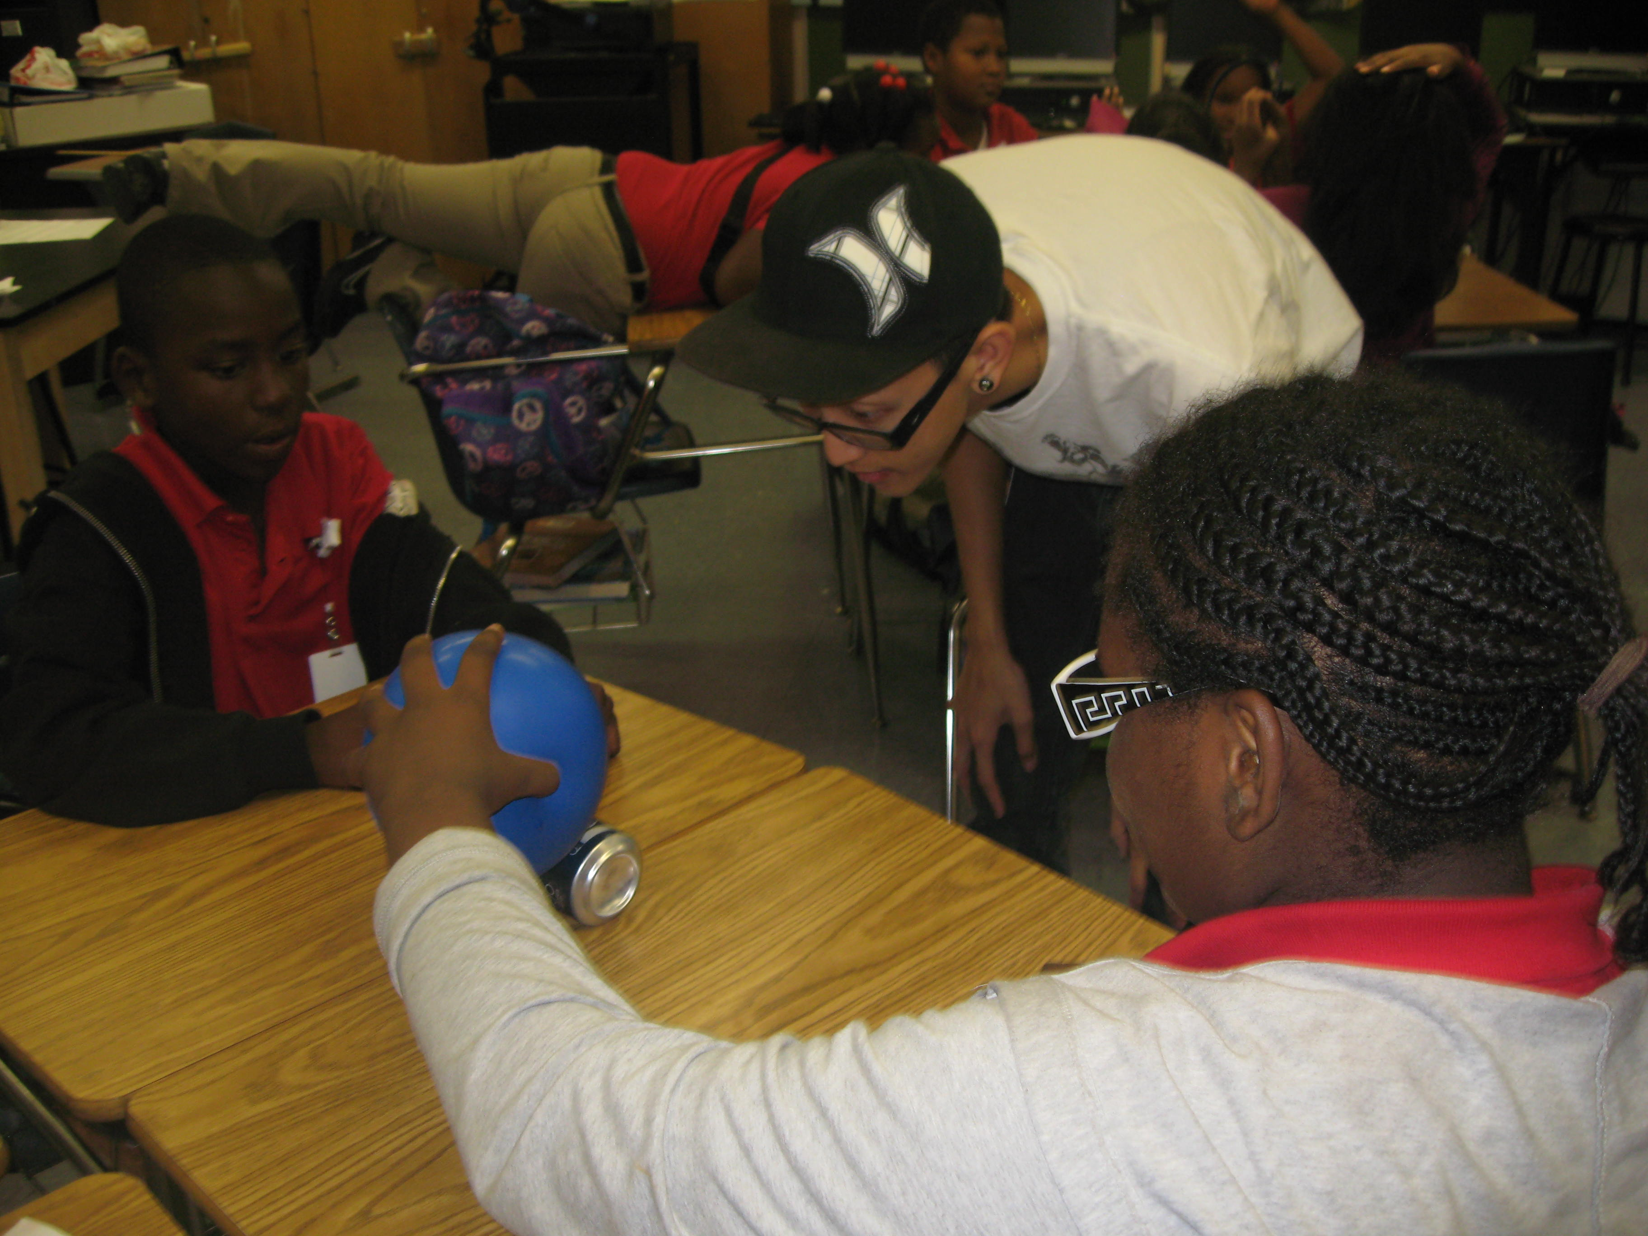
Learning About Static Electricity

Slide 9
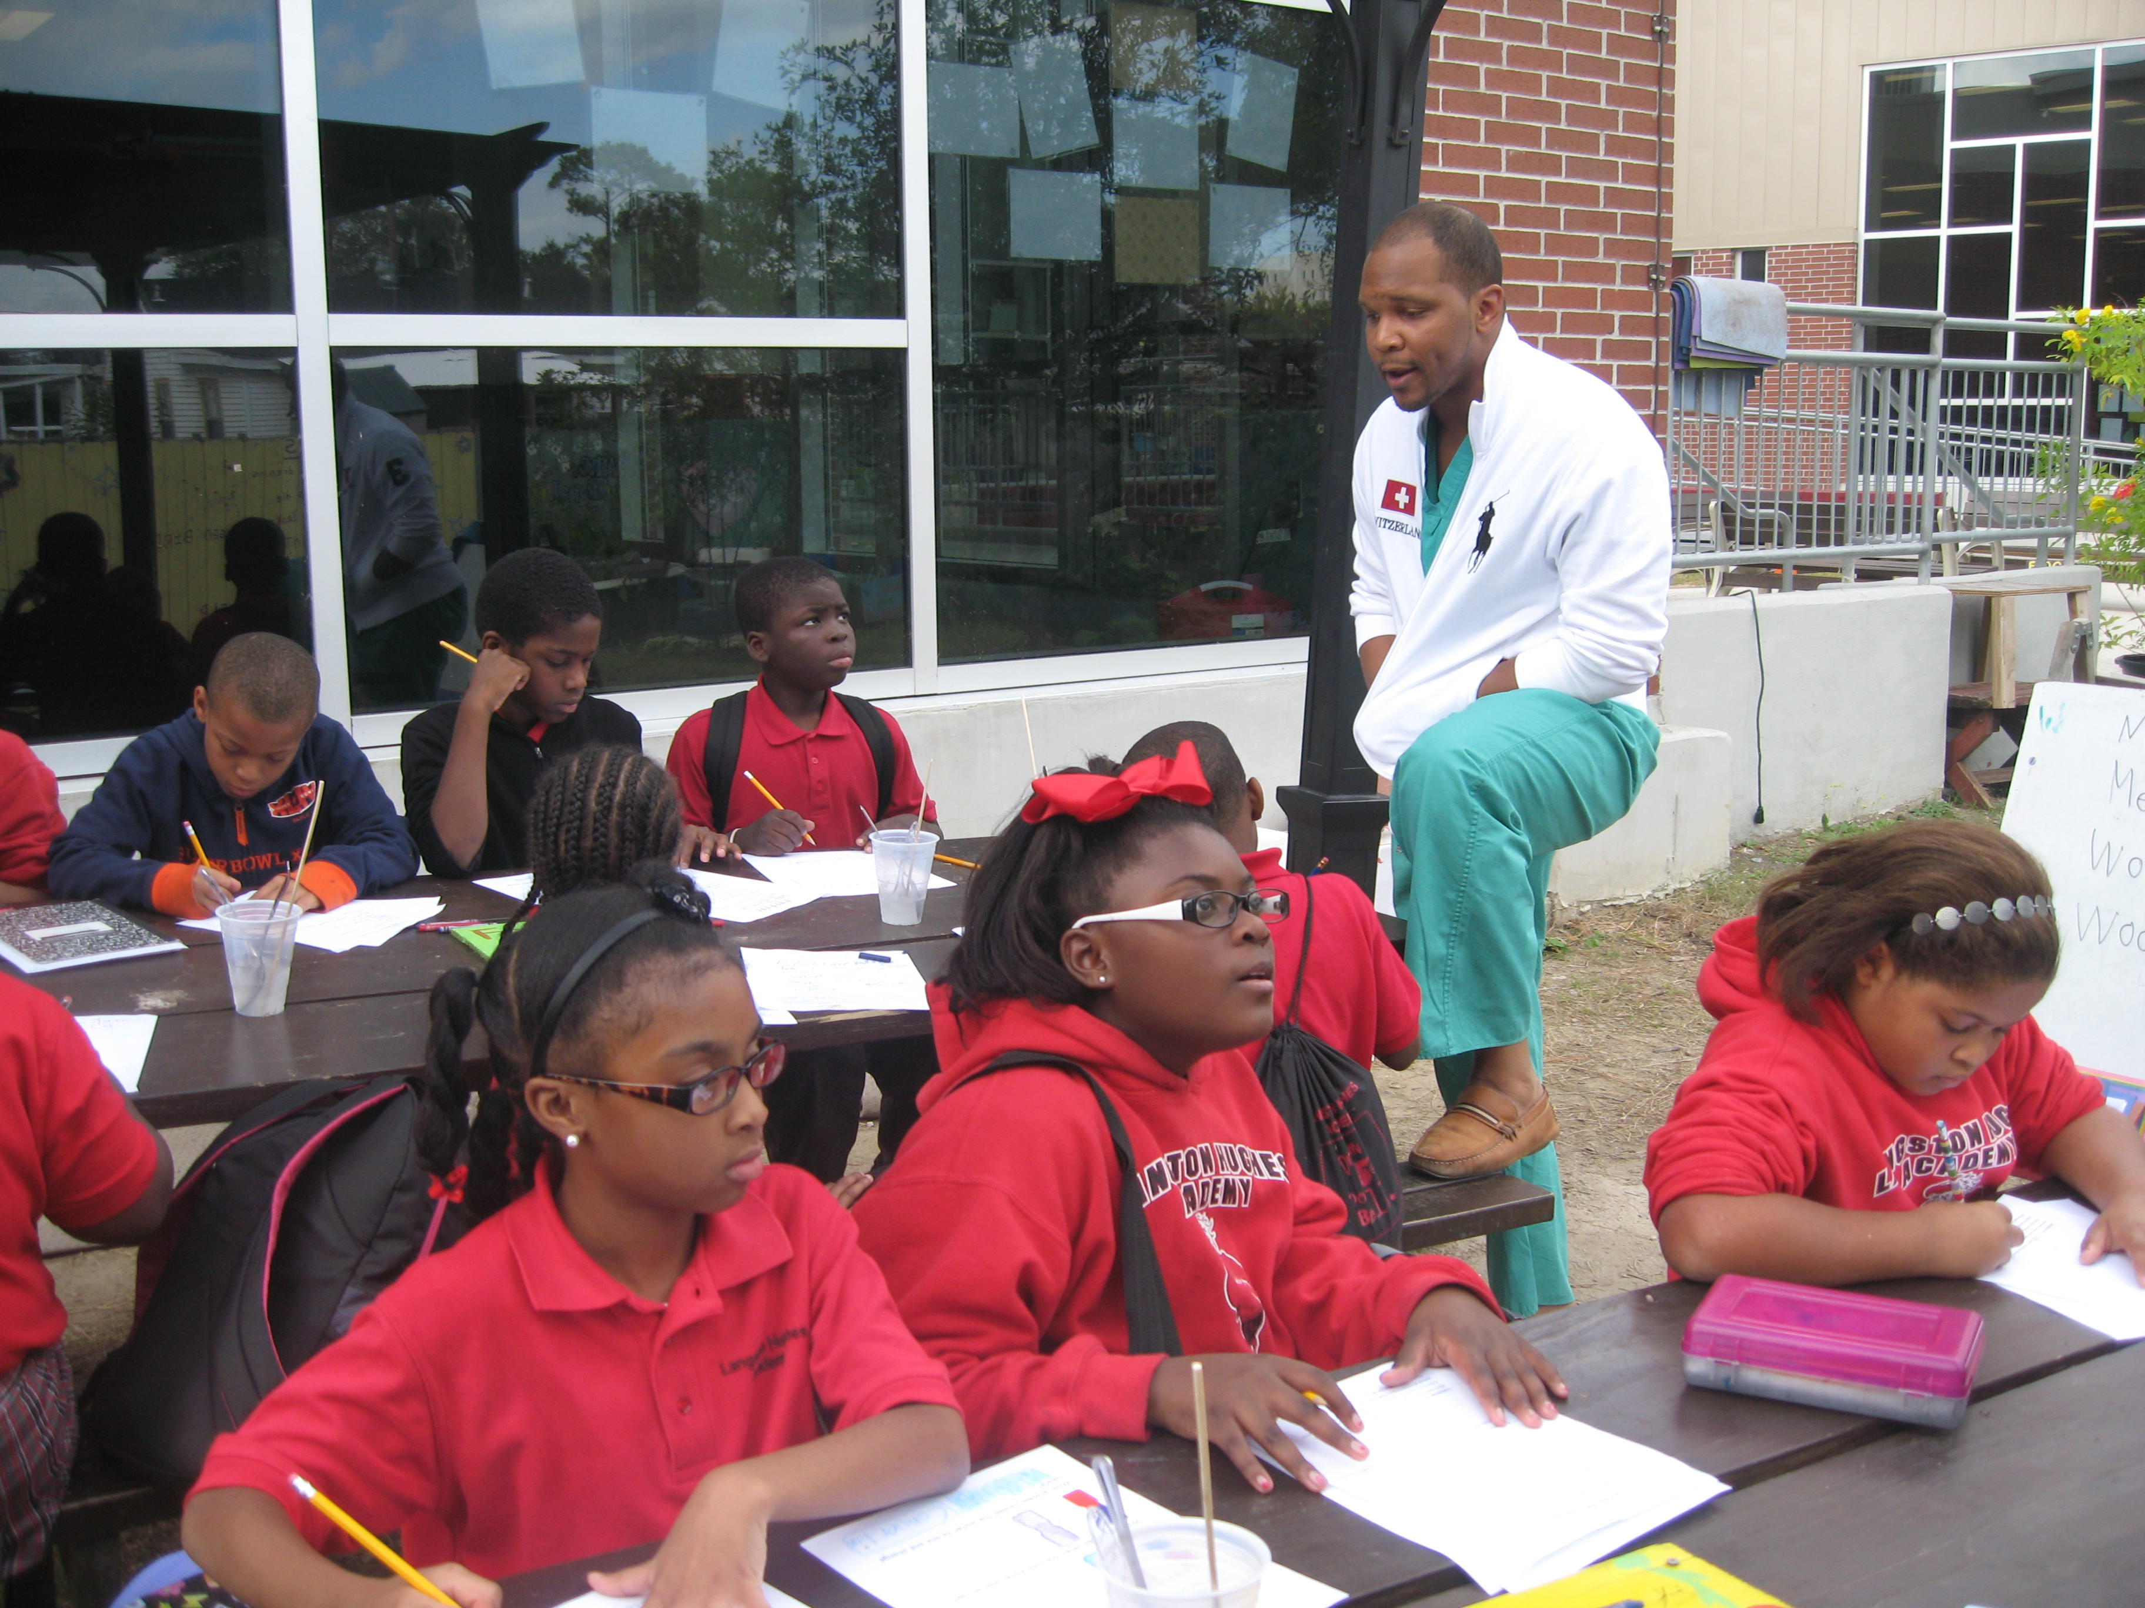
Learning About Heat

Slide 10
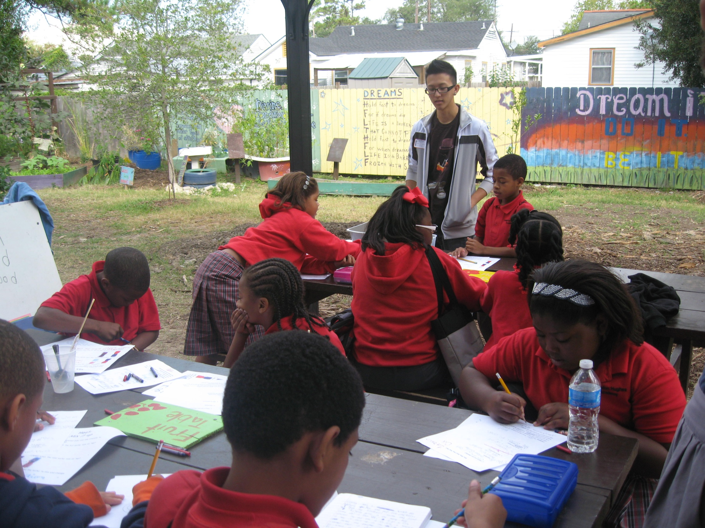
Learning About Heat

Slide 11
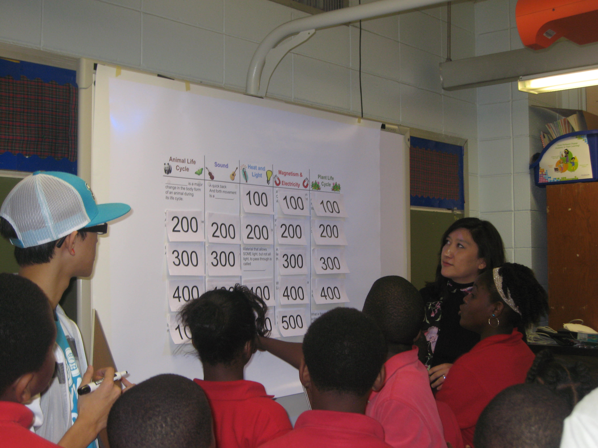
Science Jeopardy

Slide 12
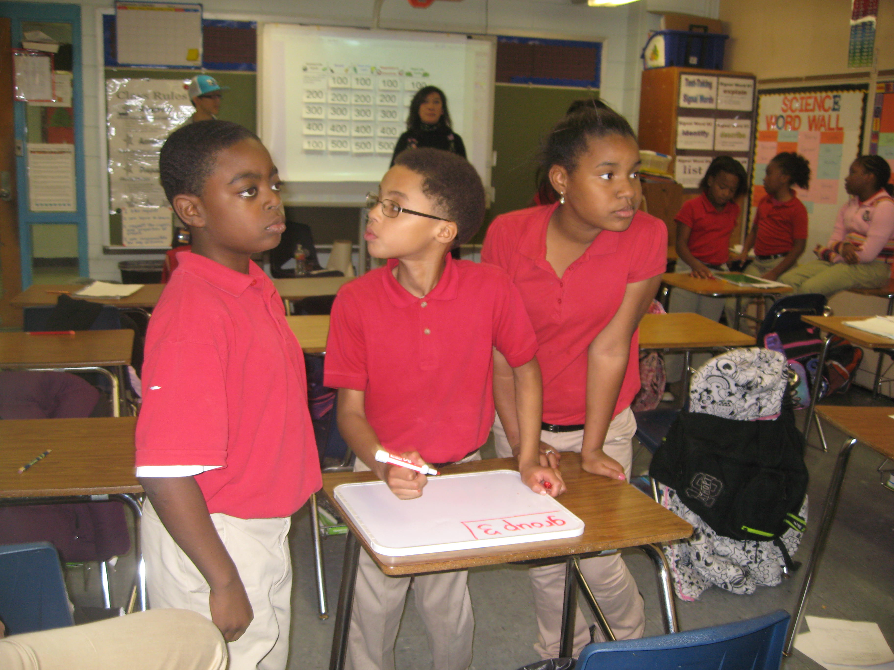
Science Jeopardy

Slide 13
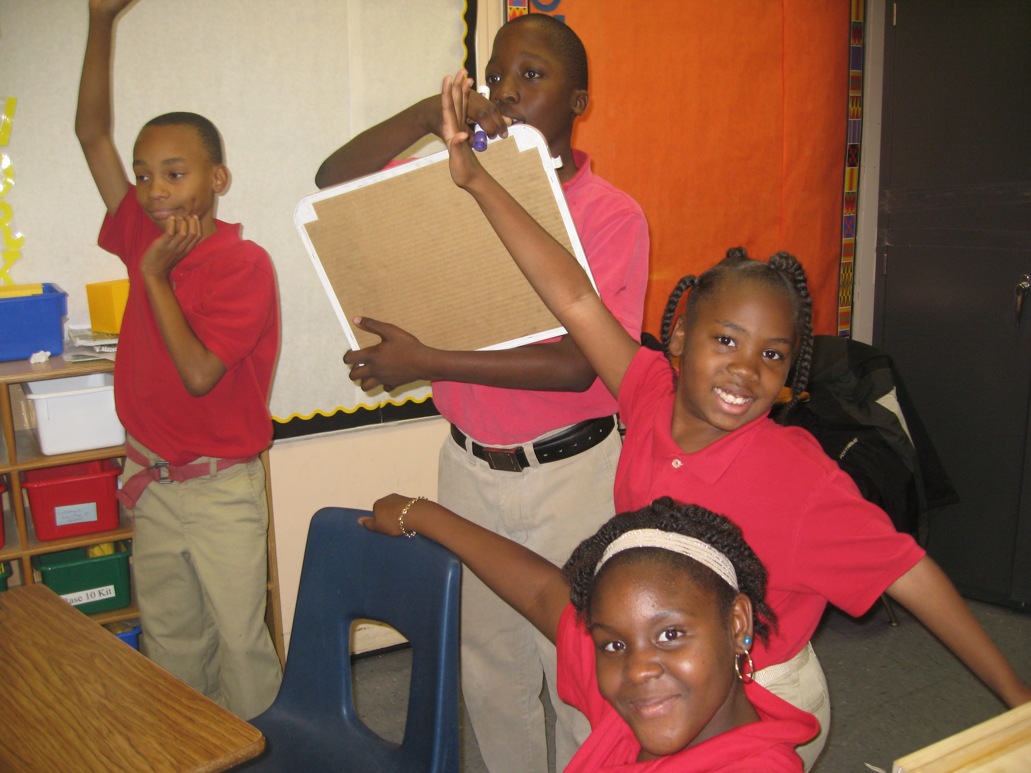
Science Jeopardy

Slide 14
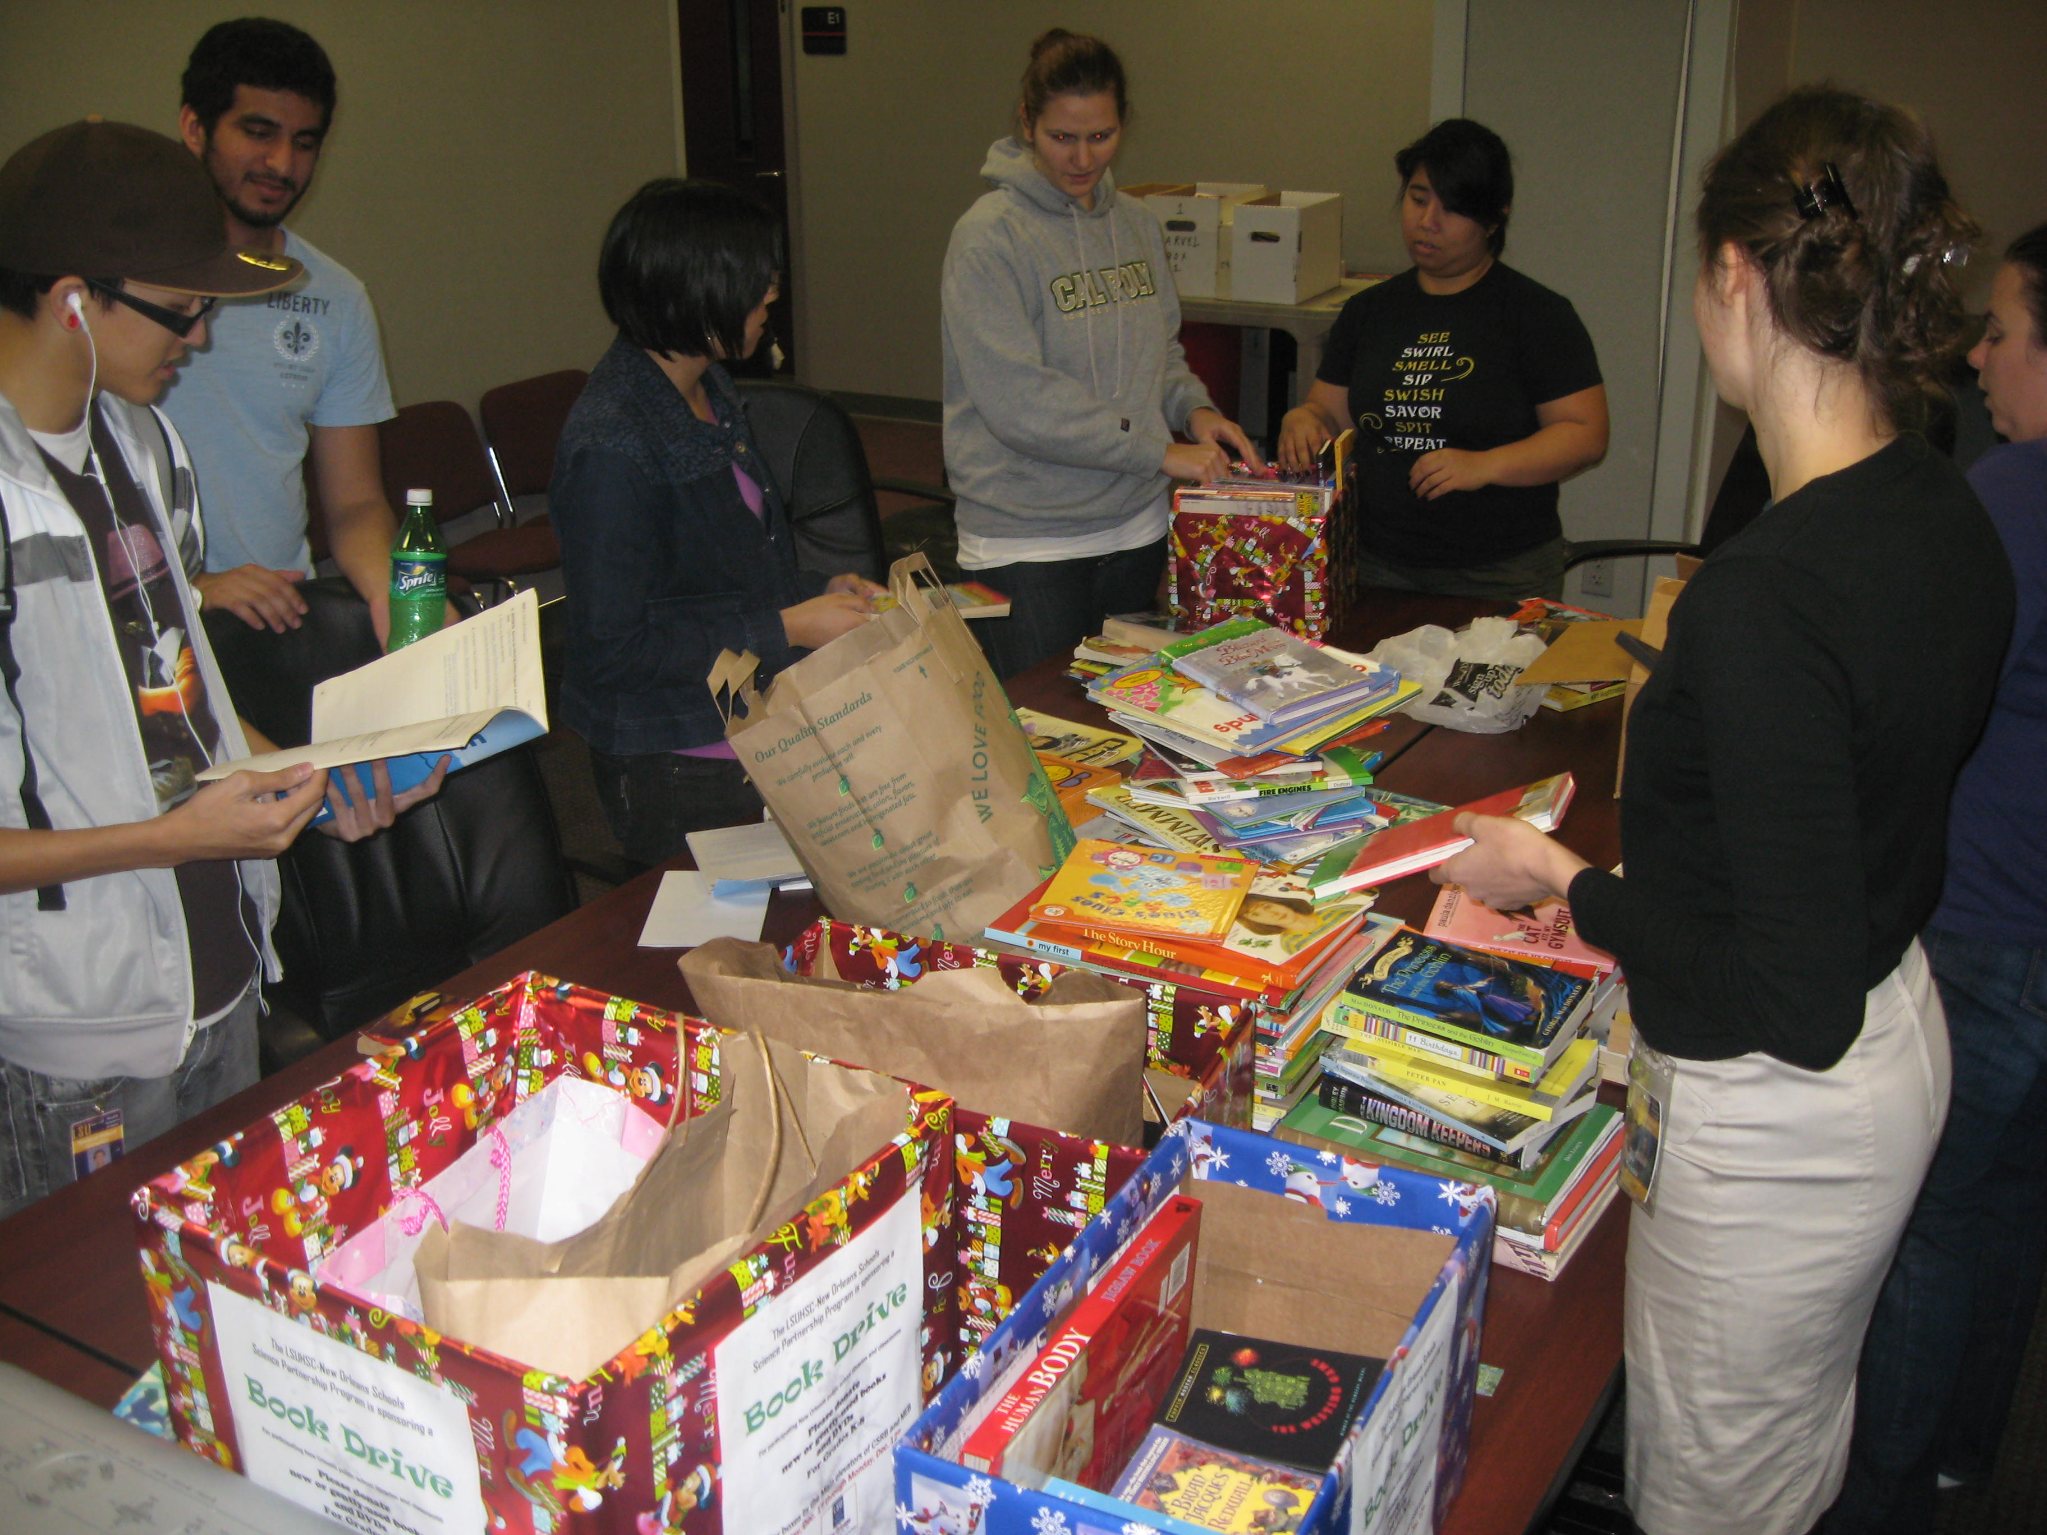
Holiday Book Drive

Slide 15
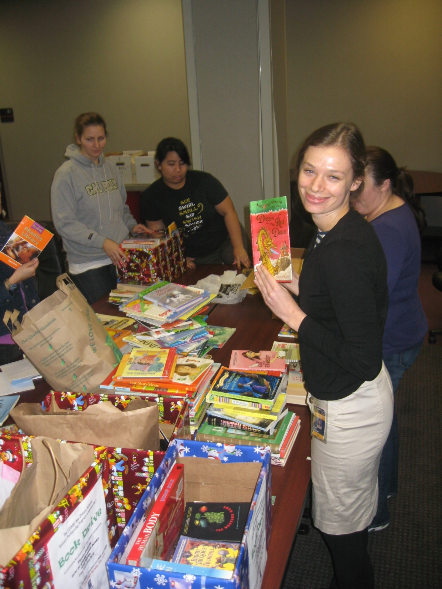
Holiday Book Drive

Slide 16
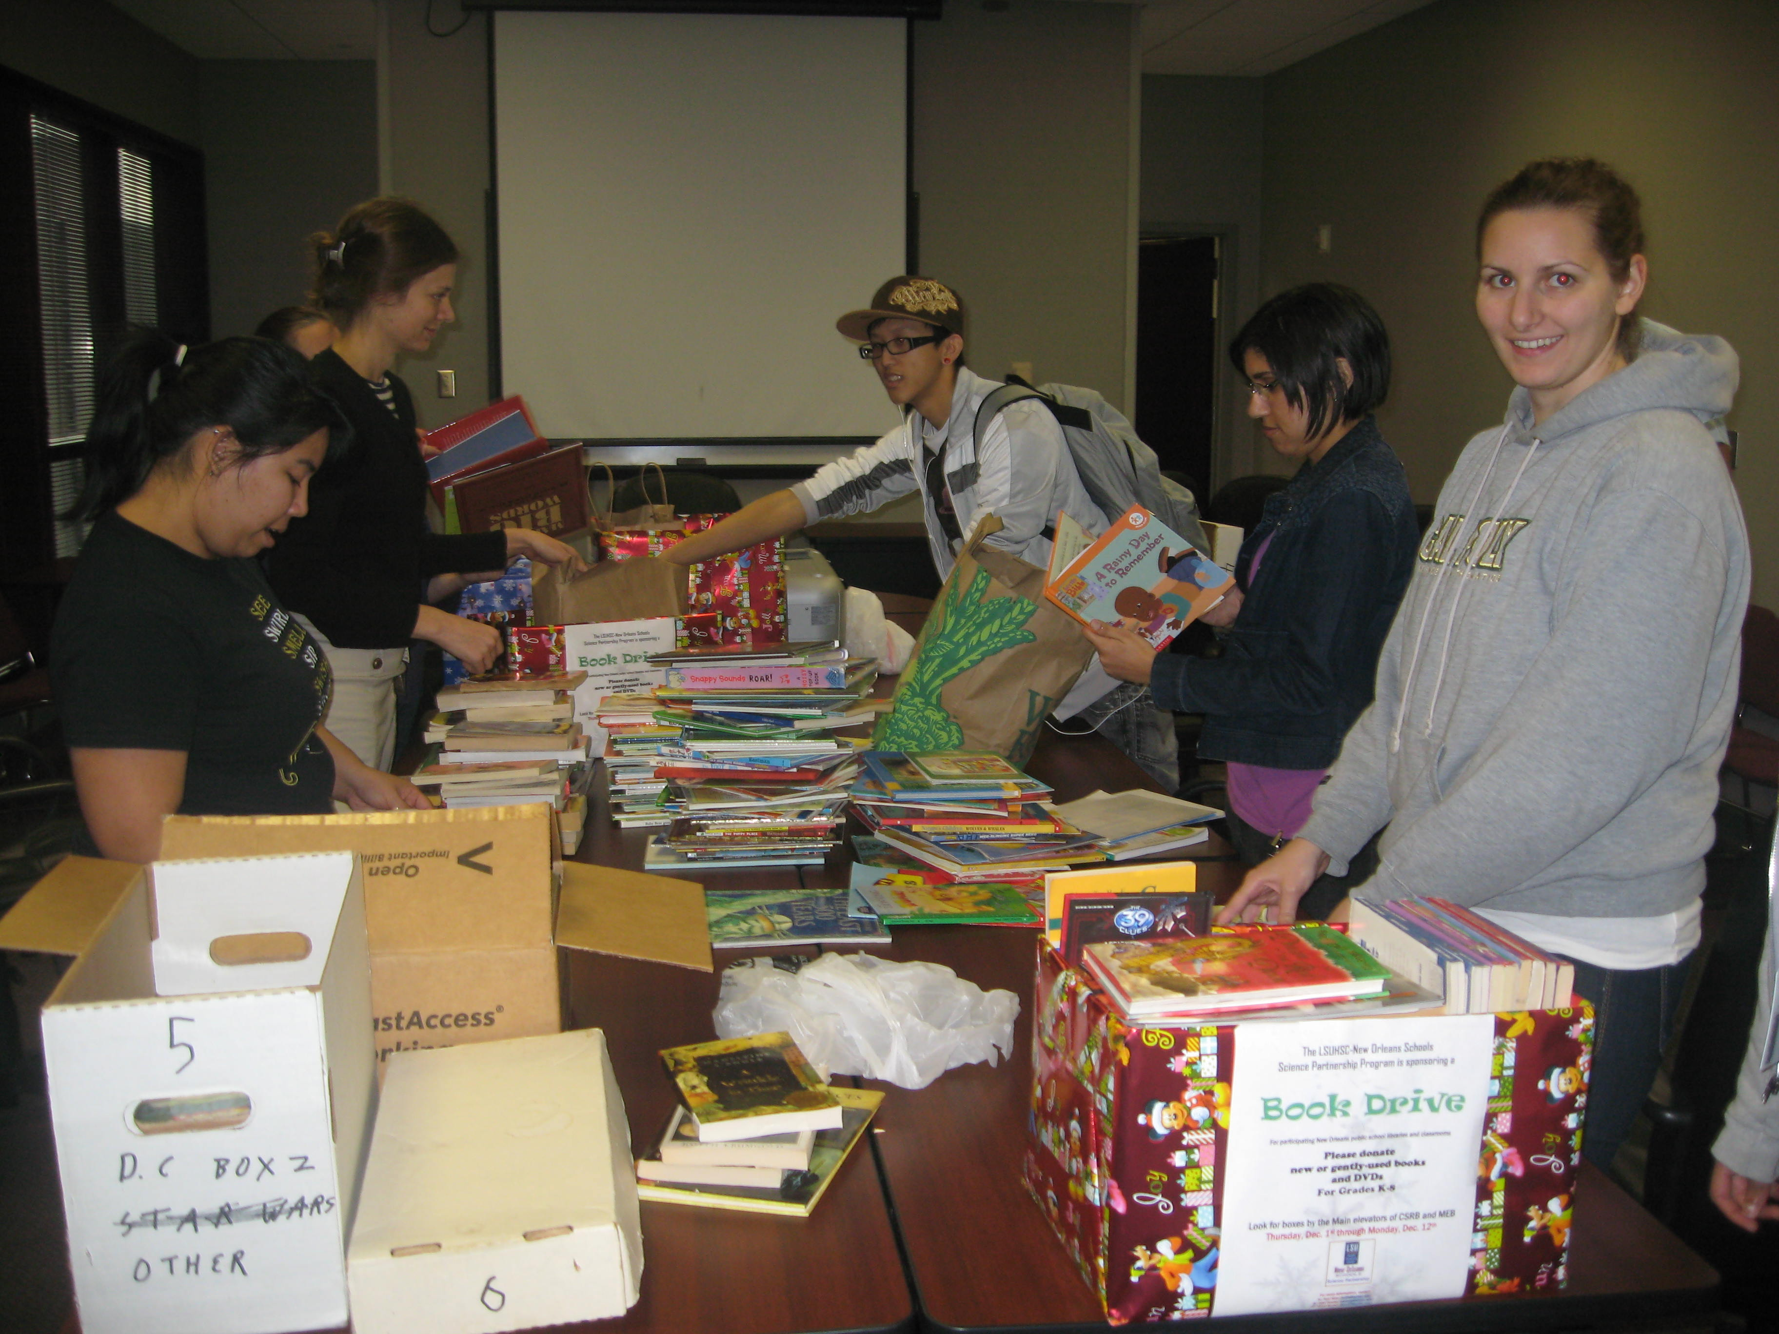
Holiday Book Drive

Slide 17
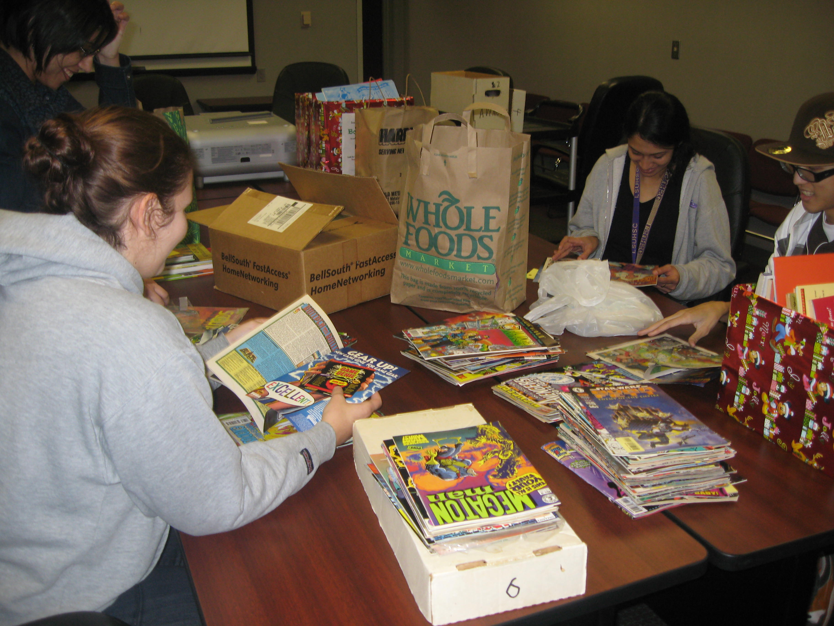
Holiday Book Drive

Slide 18
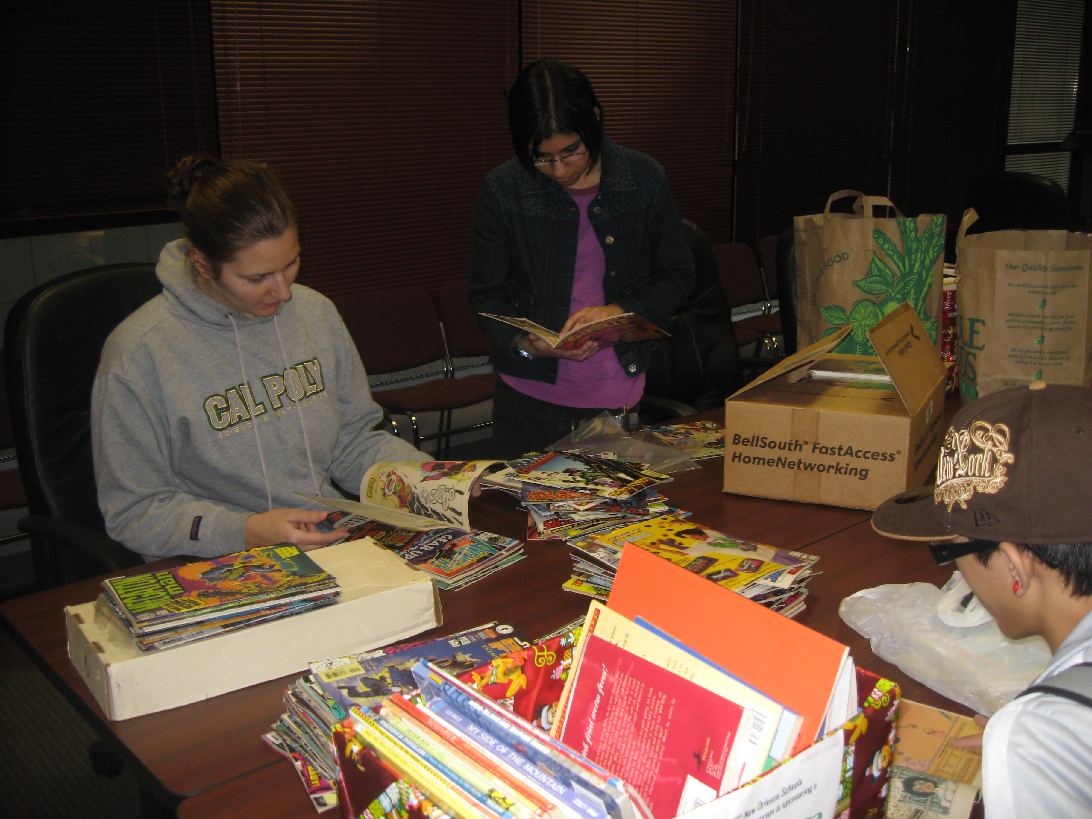
Holiday Book Drive

Slide 19
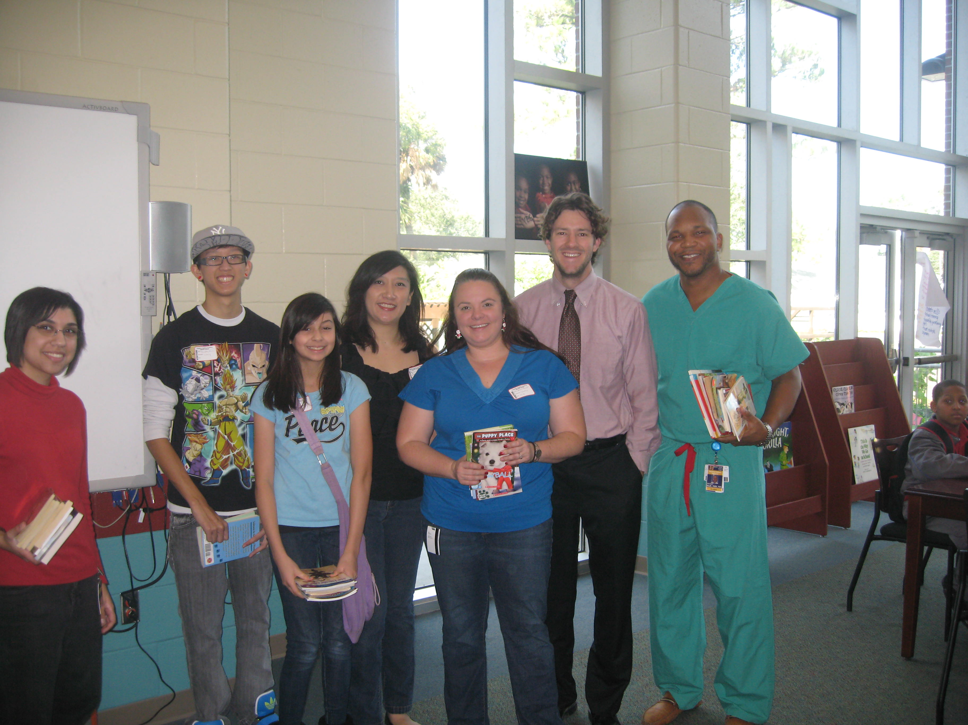
Book Donations to
Langston Hughes Academy

Slide 20
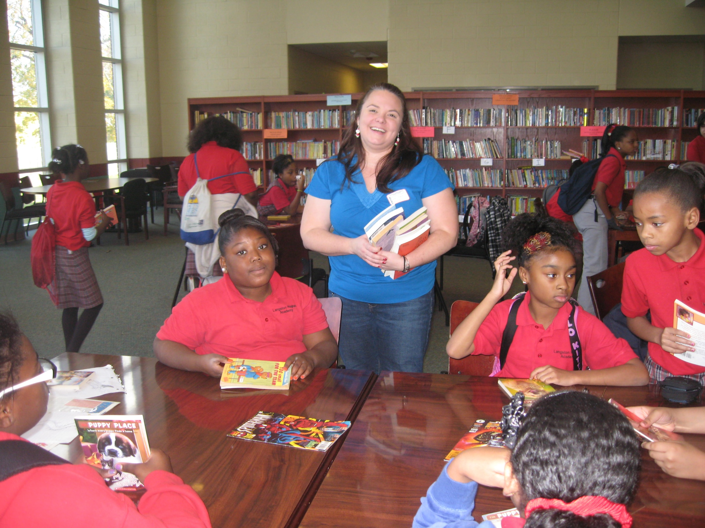
Book Donations to
Langston Hughes Academy

Slide 21
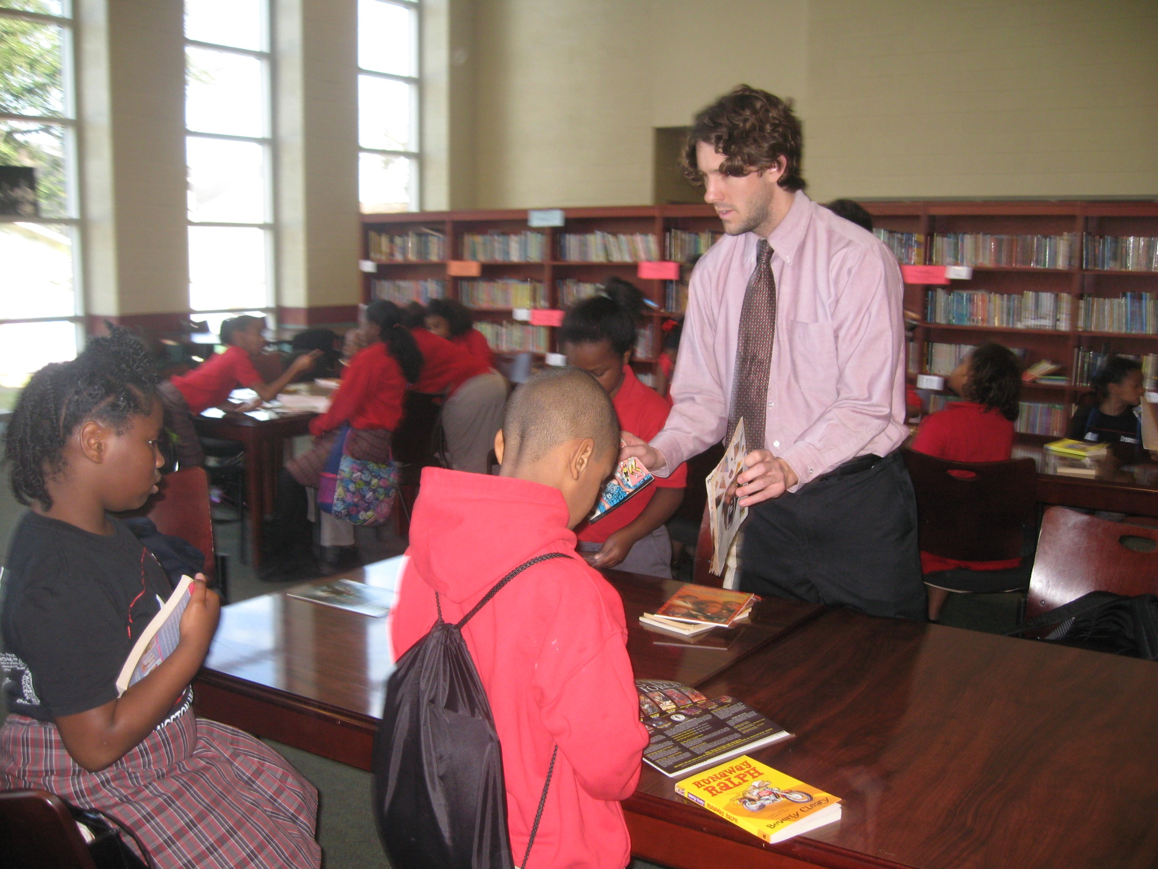
Book Donations to
Langston Hughes Academy

Slide 22
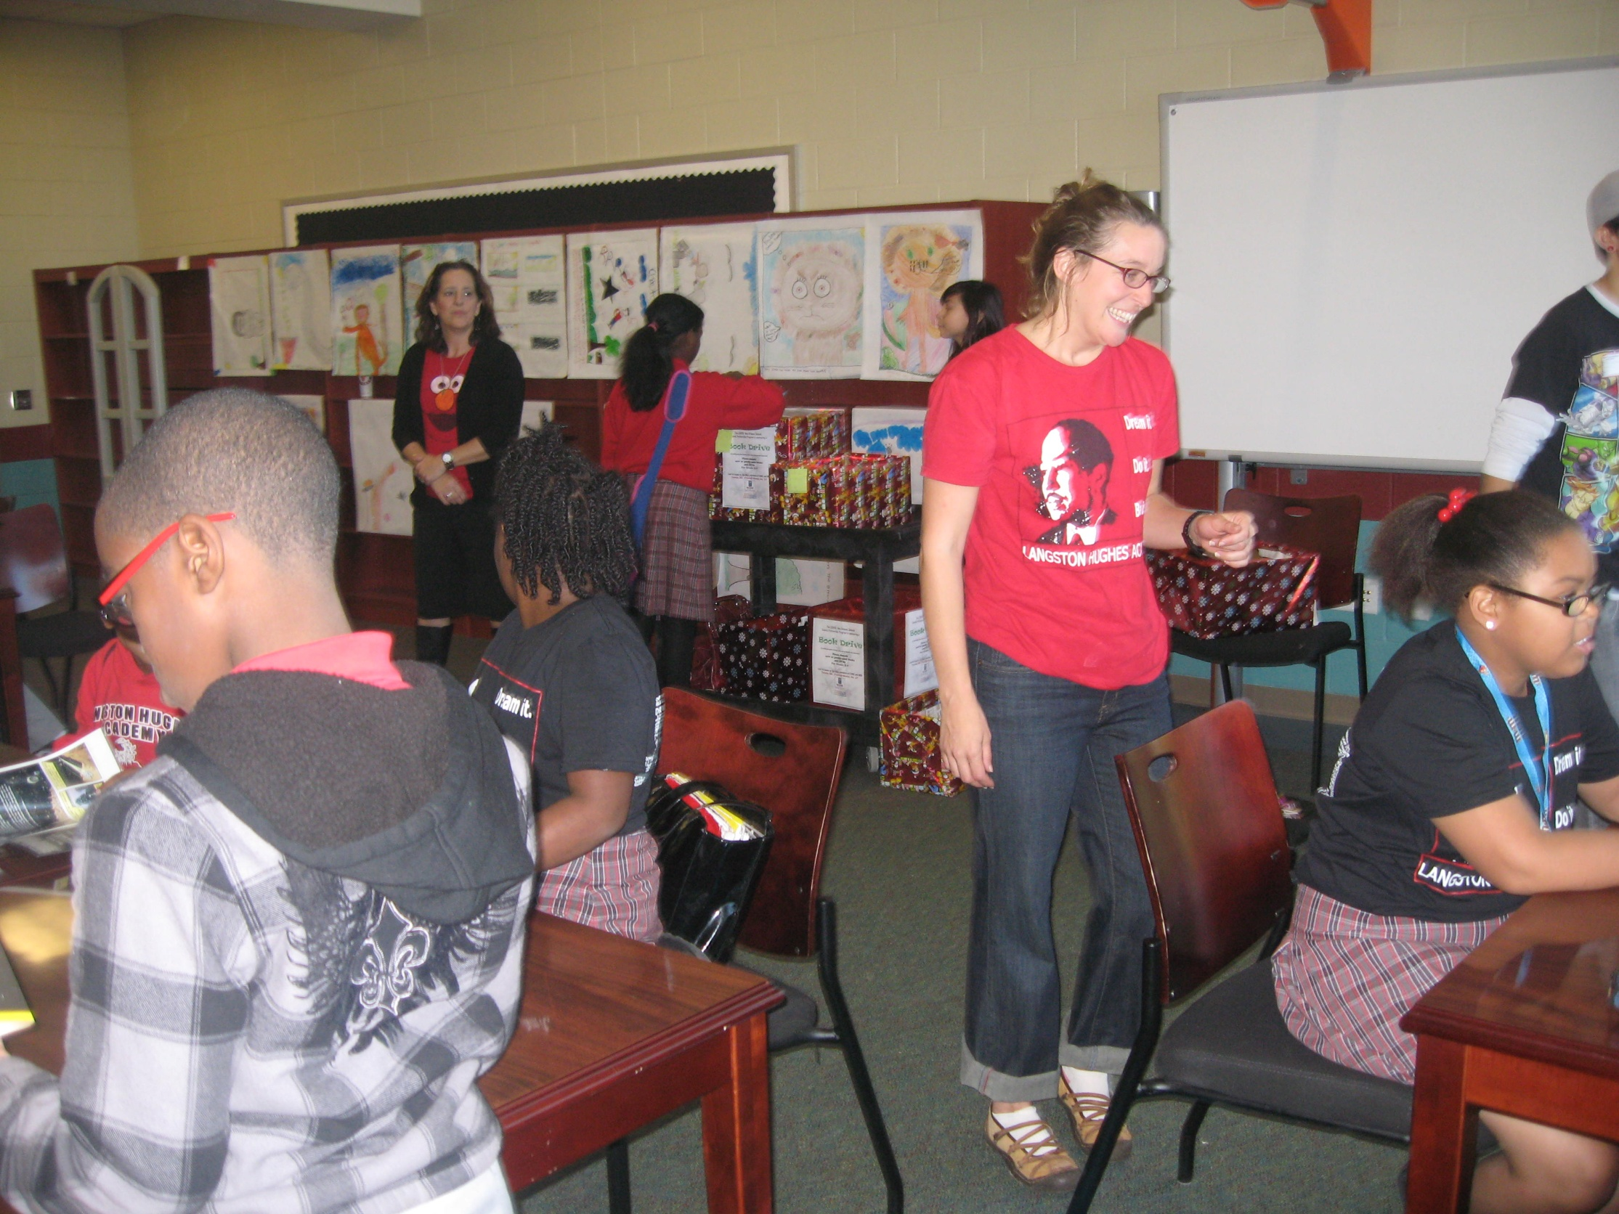
Book Donations to
Langston Hughes Academy

Slide 23
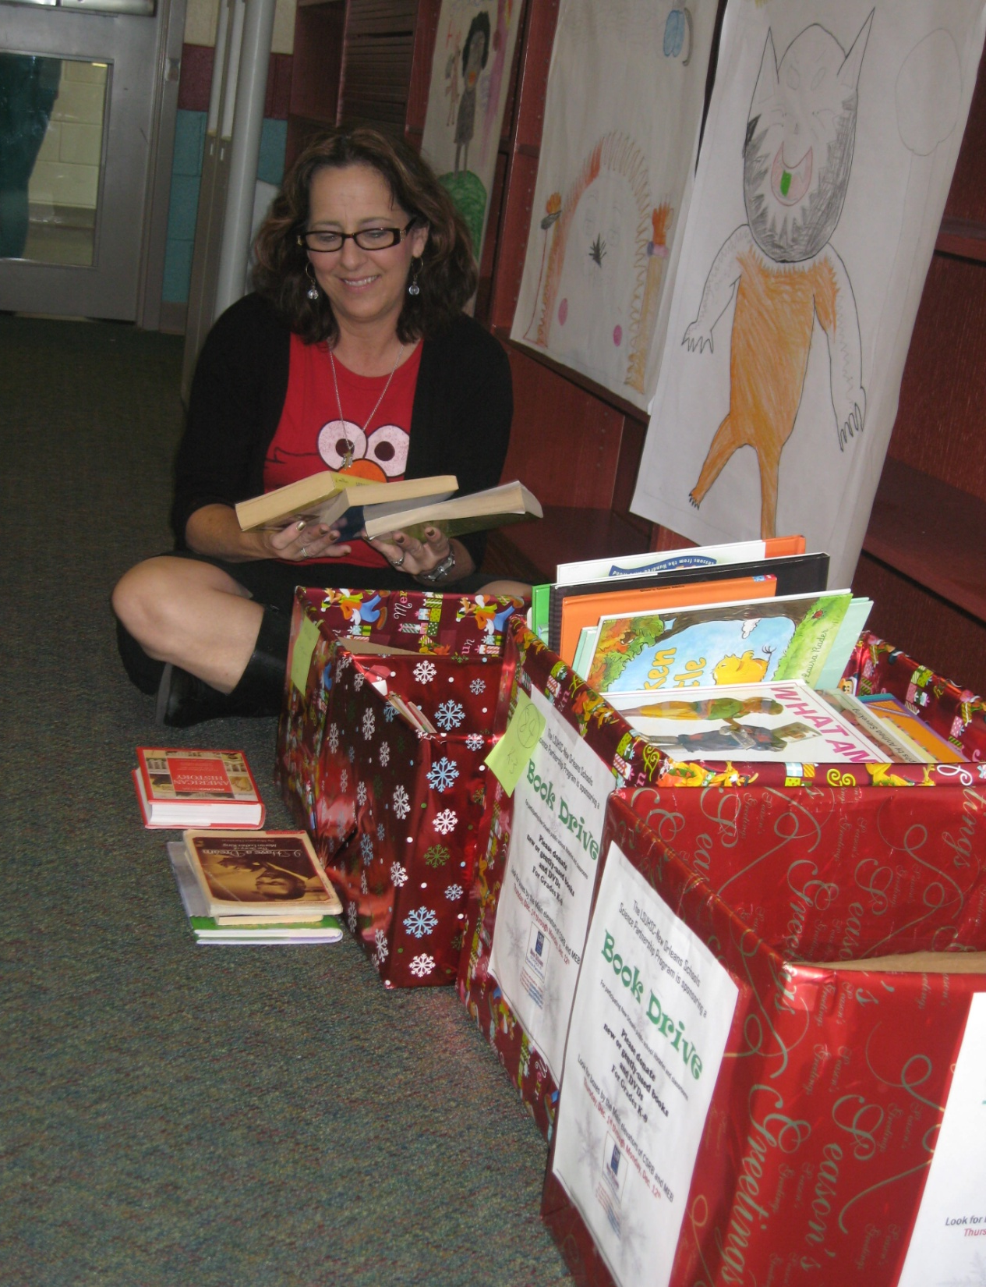
Book Donations to
Langston Hughes Academy

